Slide 1
Chapter 2: Basic Elements of C++

Slide 2
Objectives
In this chapter you will:
Become familiar with the basic components of a C++ program, including functions, special symbols, and identifiers
Explore simple data types and examine the string data type
Discover how to use arithmetic operators

Slide 3
Objectives (continued)
Examine how a program evaluates arithmetic expressions
Become familiar with the string Type
Learn what an assignment statement is and what it does
Discover how to input data into memory using input statements
Become familiar with the use of increment and decrement operators

Slide 4
Objectives (continued)
Examine ways to output results using output statements
Learn how to use preprocessor directives and why they are necessary
Explore how to properly structure a program, including using comments to document a program
Learn how to write a C++ program

Slide 5
Introduction
Computer program: sequence of statements designed to accomplish some task
Programming: planning/&creating a program
Syntax: rules that specify which statements (instructions) are legal
Programming language: a set of rules, symbols, and special words
Semantic rule: meaning of the instruction

Slide 6
C++ Programs
A C++ program is a collection of one or more subprograms, called functions
A subprogram or a function is a collection of statements that, when activated (executed), accomplishes something
Every C++ program has a function called main
The smallest individual unit of a program written in any language is called a token

Slide 7
Symbols
Special symbols
    +
    -
    *
    /
    .
    ;
    ?
    ,
    <=
    !=
    ==
    >=

Slide 8
Symbols (continued)
Word symbols
  Reserved words, or keywords
  Include:
    int
    float
    double
    char
    void
    return

Slide 9
Identifiers
Consist of letters, digits, and the underscore character (_)
Must begin with a letter or underscore
C++ is case sensitive
Some predefined identifiers are cout and cin
Unlike reserved words, predefined identifiers may be redefined, but it is not a good idea

Slide 10
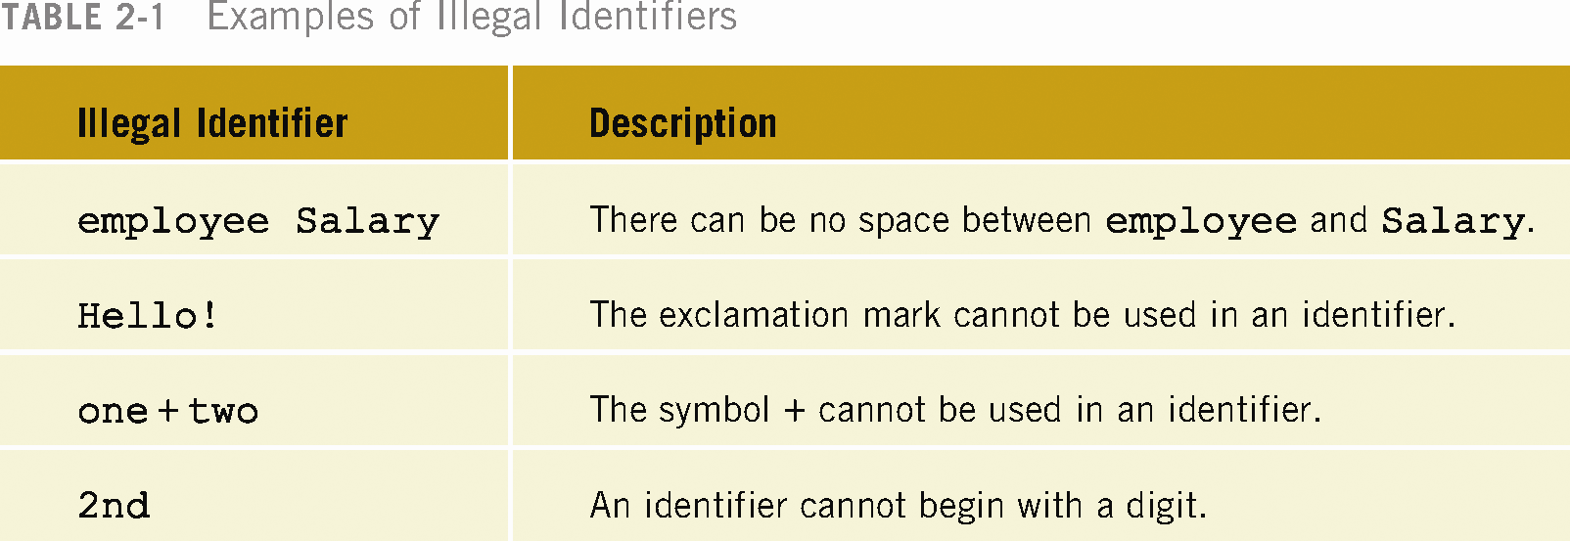
Legal and Illegal Identifiers
The following are legal identifiers in C++:
  first
  conversion
  payRate

Slide 11
Data Types
Data Type: set of values together with a set of operations is called a data type
C++ data can be classified into three categories:
  Simple data type
  Structured data type
  Pointers

Slide 12
Simple Data Types
Three categories of simple data
  Integral: integers (numbers without a decimal)
  Floating-point: decimal numbers
  Enumeration type: user-defined data type

Slide 13
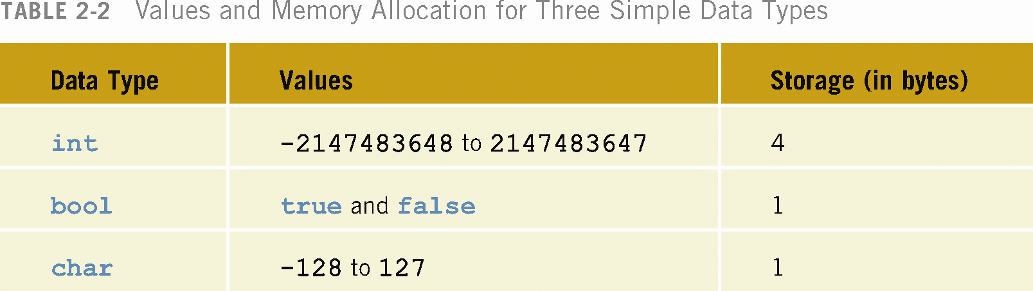

Slide 14
Bit:
  unit of data that is eight binary digits long.
    A byte is the unit most computers use to represent a character such as a letter, number, or typographic symbol (for example, "g", "5", or "?").
  A byte can also hold a string of bits that need to be used in some larger unit for application purposes
    (for example, the stream of bits that constitute a visual image for a program that displays images or the string of bits that constitutes the machine code of a computer program).
C++ Programming: From Problem Analysis to Program Design, Third EditionC++ Programming: From Problem Analysis to Program Design, Third Edition

Slide 15
In some computer systems, four bytes constitute a word, a unit that a computer processor can be designed to handle efficiently as it reads and processes each instruction.
Some computer processors can handle two-byte or single-byte instructions.
End of Lecture on 22/10/13 to be continued
C++ Programming: From Problem Analysis to Program Design, Third EditionC++ Programming: From Problem Analysis to Program Design, Third Edition

Slide 16
int Data Type
Examples:
  -6728
  0
  78
Positive integers do not have to have a + sign in front of them
No commas are used within an integer
Commas are used for separating items in a list

Slide 17
bool Data Type
bool type
  Has two values, true and false
  Manipulate logical (Boolean) expressions
true and false are called logical values
bool, true, and false are reserved words

Slide 18
char Data Type
The smallest integral data type
Used for characters: letters, digits, and special symbols
Each character is enclosed in single quotes
Some of the values belonging to char data type are: 'A', 'a', '0', '*', '+', '$', '&'
A blank space is a character and is written ' ', with a space left between the single quotes

Slide 19
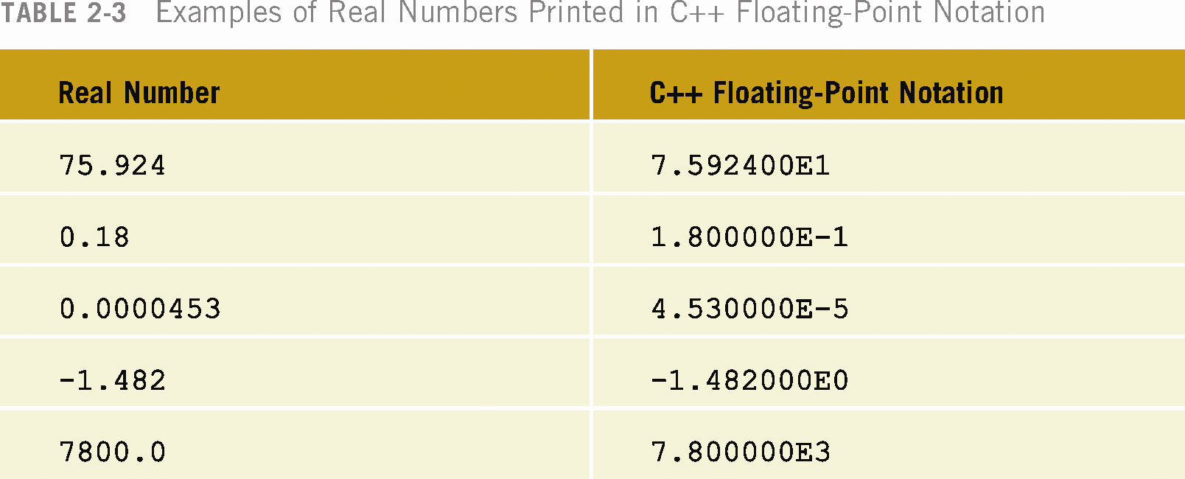
Floating-Point Data Types
C++ uses scientific notation to represent real numbers (floating-point notation)

Slide 20
Floating-Point Data Types (continued)
float: represents any real number
  Range: -3.4E+38 to 3.4E+38
Memory allocated for the float type is 4 bytes
double: represents any real number
  Range: -1.7E+308 to 1.7E+308
Memory allocated for double type is 8 bytes
On most newer compilers, data types double and long double are same

Slide 21
Floating-Point Data Types (continued)
Maximum number of significant digits (decimal places) for float values is 6 or 7
Float values are called single precision
Maximum number of significant digits for double is 15
Double values are called double precision
Precision: maximum number of significant digits

Slide 22
Arithmetic Operators
C++ Operators
  + addition
  - subtraction
  * multiplication
  / division
  % remainder (mod operator)
+, -, *, and / can be used with integral and floating-point data types
Unary operator - has only one operand
Binary Operator - has two operands

Slide 23
Order of Precedence
All operations inside of () are evaluated first
*, /, and % are at the same level of precedence and are evaluated next
+ and – have the same level of precedence and are evaluated last
When operators are on the same level
  Performed from left to right

Slide 24
Expressions
If all operands are integers
  Expression is called an integral expression
If all operands are floating-point
  Expression is called a floating-point expression
An integral expression yields integral result
A floating-point expression yields a floating-point result

Slide 25
Mixed Expressions
Mixed expression:
  Has operands of different data types
  Contains integers and floating-point
Examples of mixed expressions:
  2 + 3.5
  6 / 4 + 3.9
  5.4 * 2 – 13.6 + 18 / 2

Slide 26
Evaluating Mixed Expressions
If operator has same types of operands
  Evaluated according to the type of the operands
If operator has both types of operands
  Integer is changed to floating-point
  Operator is evaluated
  Result is floating-point

Slide 27
Evaluating Mixed Expressions (continued)
Entire expression is evaluated according to precedence rules
  Multiplication, division, and modulus are evaluated before addition and subtraction
  Operators having same level of precedence are evaluated from left to right
  Grouping is allowed for clarity

Slide 28
Type Conversion (Casting)
Implicit type coercion: when value of one type is automatically changed to another type
Cast operator provides explicit type conversion
Use the following form:
  static_cast<dataTypeName>(expression)

Slide 29
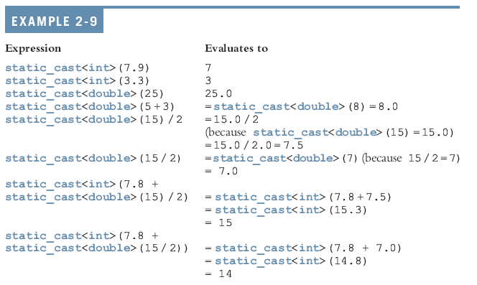

Slide 30
string Data Type
Programmer-defined type supplied in standard library
Sequence of zero or more characters
Enclosed in double quotation marks
Null: a string with no characters
Each character has relative position in string
Position of first character is 0, the position of the second is 1, and so on
Length: number of characters in string

Slide 31
Input
Data must be loaded into main memory before it can be manipulated
Storing data in memory is a two-step process:
  Instruct the computer to allocate memory
  Include statements to put data into allocated memory

Slide 32

Allocating Memory
Named Constant: memory location whose content can’t change during execution
The syntax to declare a named constant is:
In C++, const is a reserved word

Slide 33



Slide 34


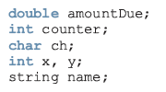
Variable: memory location whose content may change during execution

Slide 35
Assignment Statement
The assignment statement takes the form:
variable = expression;
Expression is evaluated and its value is assigned to the variable on the left side
In C++ = is called the assignment operator

Slide 36




Slide 37
A C++ statement such as:
i = i + 2;
evaluates whatever is in i, adds two to it, and assigns the new value to the memory location i

Slide 38
Declaring & Initializing Variables
Variables can be initialized when declared:
int first=13, second=10;
char ch=' ';
double x=12.6, y=123.456;
first and second are int variables with the values 13 and 10, respectively
ch is a char variable whose value is empty
x and y are double variables with 12.6 and 123.456, respectively

Slide 39
Input (Read) Statement
cin is used with >> to gather input
cin >> variable >> variable. . .;
The extraction operator is >>
For example, if miles is a double variable
cin >> miles;
  Causes computer to get a value of type double
  Places it in the memory cell miles

Slide 40
Input Statement (continued)
Using more than one variable in cin allows more than one value to be read at a time
For example, if feet and inches are variables of type int a statement such as:
cin >> feet >> inches;
  Inputs two integers from the keyboard
  Places them in locations feet and inches respectively

Slide 41
Example 2-17
#include <iostream>
#include <string>
using namespace std;
int main()
{
string firstName; //Line 1
string lastName; //Line 2
int age; //Line 3
double weight; //Line 4
cout << "Enter first name, last name, age, "
<< "and weight, separated by spaces."
<< endl; //Line 5
cin >> firstName >> lastName; //Line 6
cin >> age >> weight; //Line 7
cout << "Name: " << firstName << " "
<< lastName << endl; //Line 8
cout << "Age: " << age << endl; //Line 9
cout << "Weight: " << weight << endl; //Line 10
return 0; //Line 11
}

Slide 42
Sample Run:
Enter first name, last name, age, and weight, separated by spaces.
Sheila Mann 23 120.5
Name: Sheila Mann
Age: 23
Weight: 120.5

Slide 43
Increment & Decrement Operators
Increment operator: increment variable by 1
Decrement operator: decrement variable by 1
Pre-increment: ++variable
Post-increment: variable++
Pre-decrement: --variable
Post-decrement: variable--

Slide 44
Increment & Decrement Operators (continued)
++count; or count++; increments the value of count by 1
--count; or count--; decrements the value of count by
If x = 5; and y = ++x;
  After the second statement both x and y are 6
If x = 5; and y = x++;
  After the second statement y is 5 and x is 6

Slide 45
Output
The syntax of cout and << is:
cout<< expression or manipulator
<< expression or manipulator
<< ...;
Called an output (cout) statement
The << operator is called the insertion operator or the stream insertion operator
Expression evaluated and its value is printed at the current cursor position on the screen

Slide 46
Output (continued)
Manipulator: alters output
endl: the simplest manipulator
  Causes cursor to move to beginning of the next line

Slide 47
Output Example
Output of the C++ statement
cout << a;
is meaningful if a has a value
  For example, the sequence of C++ statements,
a = 45;
cout << a;
produces an output of 45

Slide 48
The New Line Character
The new line character is '\n'
Without this character the output is printed on one line
Tells the output to go to the next line
When \n is encountered in a string
  Cursor is positioned at the beginning of next line
A \n may appear anywhere in the string

Slide 49
Examples
Without the new line character:
  cout << "Hello there.";
  cout << "My name is James.";
  Would output:
  Hello there.My name is James.
With the new line character:
  cout << "Hello there.\n";
  cout << "My name is James.";
  Would output
  Hello there.
  My name is James.

Slide 50
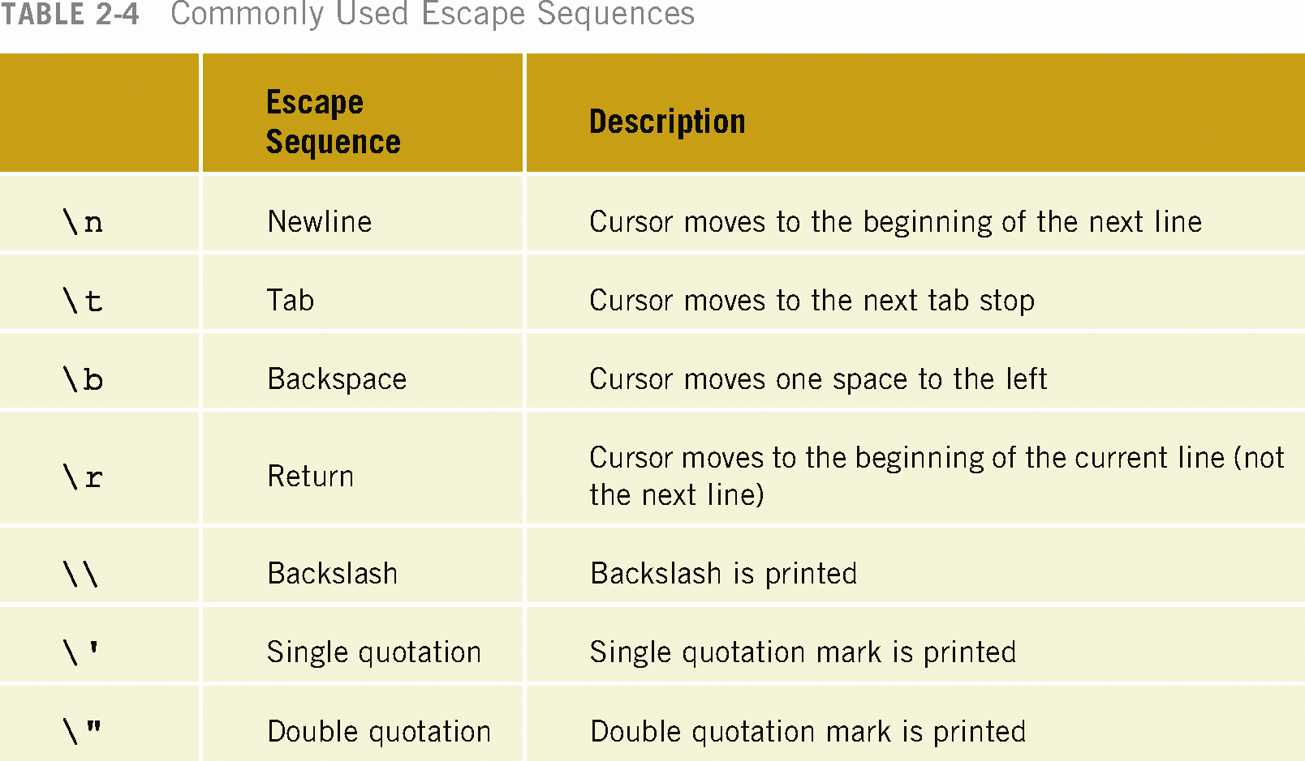

Slide 51
Preprocessor Directives
C++ has a small number of operations
Many functions and symbols needed to run a C++ program are provided as collection of libraries
Every library has a name and is referred to by a header file
Preprocessor directives are commands supplied to the preprocessor
All preprocessor commands begin with #
No semicolon at the end of these commands

Slide 52
Preprocessor Directive Syntax
Syntax to include a header file
#include <headerFileName>
Causes the preprocessor to include the header file iostream in the program
The syntax is:
#include <iostream>

Slide 53
Header Files
In older versions of C++
  Header files had the file extension .h
ANSI C++ removes this extension
The descriptions of the functions needed to perform I/O are contained in iostream
The syntax is:
  #include <iostream>

Slide 54
Using cin and cout in a Program and namespace
cin and cout are declared in the header file iostream, but within a namespace named std
To use cin and cout in a program, use the following two statements:
#include <iostream>
using namespace std;

Slide 55
Using the string Data Type in a Program
To use the string type, you need to access its definition from the header file string
Include the following preprocessor directive:
#include <string>

Slide 56
Creating a C++ Program
C++ program has two parts:
  Preprocessor directives
  The program
Preprocessor directives and program statements constitute C++ source code
Source code must be saved in a file with the file extension .cpp

Slide 57
Creating a C++ Program (continued)
Compiler generates the object code
  Saved in a file with file extension .obj
Executable code is produced and saved in a file with the file extension .exe.

Slide 58
Declaration Statements
  int a, b, c;
double x, y;
  Variables can be declared anywhere in the program, but they must be declared before they can be used
Executable Statements have three forms:
  a = 4; //assignment statement
cin >> b; //input statement
cout << a << " " << b << endl; //output statement

Slide 59
Example 2-28
#include <iostream> //Line 1
using namespace std; //Line 2
const int NUMBER = 12; //Line 3
int main() //Line 4
{ //Line 5
int firstNum; //Line 6
int secondNum; //Line 7
firstNum = 18; //Line 8
cout << "Line 9: firstNum = " << firstNum
<< endl; //Line 9
cout << "Line 10: Enter an integer: "; //Line 10
cin >> secondNum; //Line 11
cout << endl; //Line 12
cout << "Line 13: secondNum = " << secondNum
<< endl; //Line 13
firstNum = firstNum + NUMBER + 2 * secondNum; //Line 14
cout << "Line 15: The new value of "
<< "firstNum = " << firstNum << endl; //Line 15
return 0; //Line 16
}

Slide 60
Sample Run:
Line 9: firstNum = 18
Line 10: Enter an integer: 15
Line 13: secondNum = 15
Line 15: The new value of firstNum = 60

Slide 61
Program Style and Form
The Program Part
  Every C++ program has a function main
  Basic parts of function main are:
    The heading
    The body of the function
The heading part has the following form
typeOfFunction main(argument list)

Slide 62
Syntax
Errors in syntax are found in compilation
  int x; //Line 1
  int y //Line 2: syntax error
  double z; //Line 3
  y = w + x; //Line 4: syntax error

Slide 63
Use of Blanks
Use of Blanks
  One or more blanks separate input numbers
  Blanks are also used to separate reserved words and identifiers from each other and other symbols
Blanks between identifiers in the second statement are meaningless:
  int a,b,c;
  int a, b, c;
In the statement: inta,b,c;
no blank between the t and a changes the reserved word int and the identifier a into a new identifier, inta.

Slide 64
Semicolons, Brackets, & Commas
Commas separate items in a list
All C++ statements end with a semicolon
Semicolon is also called a statement terminator
{ and } are not C++ statements

Slide 65
Semantics
Possible to remove all syntax errors in a program and still not have it run
Even if it runs, it may still not do what you meant it to do
For example,
  2 + 3 * 5 and (2 + 3) * 5
are both syntactically correct expressions, but have different meanings

Slide 66
Form and Style
Consider two ways of declaring variables:
  Method 1
int feet, inch;
double x, y;
  Method 2
  int a,b;double x,y;
Both are correct, however, the second is hard to read

Slide 67
Documentation
Comments can be used to document code
  Single line comments begin with // anywhere in the line
  Multiple line comments are enclosed between /* and */
Name identifiers with meaningful names
Run-together-words can be handled either by using CAPS for the beginning of each new word or an underscore before the new word

Slide 68
Assignment Statements
C++ has special assignment statements called compound assignment
  +=, -=, *=, /=, and %=
Example:
x *= y;

Slide 69
Programming Example
Write a program that takes as input a given length expressed in feet and inches
  Convert and output the length in centimeters
Input: Length in feet and inches
Output: Equivalent length in centimeters
Lengths are given in feet and inches
Program computes the equivalent length in centimeters
One inch is equal to 2.54 centimeters

Slide 70
Programming Example (continued)
Convert the length in feet and inches to all inches:
  Multiply the number of feet by 12
  Add given inches
Use the conversion formula (1 inch = 2.54 centimeters) to find the equivalent length in centimeters

Slide 71
Programming Example (continued)
The algorithm is as follows:
  Get the length in feet and inches
  Convert the length into total inches
  Convert total inches into centimeters
  Output centimeters

Slide 72
Variables and Constants
Variables
int feet; //variable to hold given feet
int inches; //variable to hold given inches
int totalInches; //variable to hold total inches
double centimeters; //variable to hold length in
//centimeters
Named Constant
const double conversion = 2.54;
const int inchesPerFoot = 12;

Slide 73
Main Algorithm
Prompt user for input
Get data
Echo the input (output the input)
Find length in inches
Output length in inches
Convert length to centimeters
Output length in centimeters

Slide 74
Putting It Together
Program begins with comments
System resources will be used for I/O
Use input statements to get data and output statements to print results
Data comes from keyboard and the output will display on the screen
The first statement of the program, after comments, is preprocessor directive to include header file iostream

Slide 75
Putting It Together (continued)
Two types of memory locations for data manipulation:
  Named constants
  Variables
Named constants are usually put before main so they can be used throughout program
This program has only one function (main), which will contain all the code
The program needs variables to manipulate data, which are declared in main

Slide 76
Body of the Function
The body of the function main has the following form:
int main ()
{
declare variables
statements
return 0;
}

Slide 77
Writing a Complete Program
Begin the program with comments for documentation
Include header files
Declare named constants, if any
Write the definition of the function main

Slide 78
//********************************************************
// Program Convert Measurements: This program converts
// measurements in feet and inches into centimeters using
// the formula that 1 inch is equal to 2.54 centimeters.
//********************************************************
//header file
#include <iostream>
using namespace std;
//named constants
const double CENTIMETERS_PER_INCH = 2.54;
const int INCHES_PER_FOOT = 12;
int main ()
{
//declare variables
int feet, inches;
int totalInches;
double centimeter;
//Statements: Step 1 - Step 7
cout << "Enter two integers, one for feet and "
<< "one for inches: "; //Step 1
cin >> feet >> inches; //Step 2
cout << endl;

Slide 79
cout << endl;
cout << "The numbers you entered are " << feet
<< " for feet and " << inches
<< " for inches. " << endl; //Step 3
totalInches = INCHES_PER_FOOT * feet + inches; //Step 4
cout << "The total number of inches = "
<< totalInches << endl; //Step 5
centimeter = CENTIMETERS_PER_INCH * totalInches;//Step 6
cout << "The number of centimeters = "
<< centimeter << endl; //Step 7
return 0;
}
Sample Run
Enter two integers, one for feet, one for inches: 15 7
The numbers you entered are 15 for feet and 7 for inches.
The total number of inches = 187
The number of centimeters = 474.98

Slide 80
Summary
C++ program: collection of functions where each program has a function called main
Identifier consists of letters, digits, and underscores, and begins with letter or underscore
The arithmetic operators in C++ are addition (+), subtraction (-),multiplication (*), division (/), and modulus (%)
Arithmetic expressions are evaluated using the precedence associativity rules

Slide 81
Summary (continued)
All operands in an integral expression are integers and all operands in a floating-point expression are decimal numbers
Mixed expression: contains both integers and decimal numbers
Use the cast operator to explicitly convert values from one data type to another
A named constant is initialized when declared
All variables must be declared before used

Slide 82
Summary (continued)
Use cin and stream extraction operator >> to input from the standard input device
Use cout and stream insertion operator << to output to the standard output device
Preprocessor commands are processed before the program goes through the compiler
A file containing a C++ program usually ends with the extension .cpp

